Slide 1

SUICIDE RATES OVERVIEW 1985 TO 2016
Aakash Atnoorkar
Sanghamitra Shanmugam
Danish Bhat

Slide 2

DID YOU KNOW?
Close to 800 000 people die by suicide every year. Furthermore, for each suicide, there are more than 20 suicide attempts.
ONE EVERY 40 SECONDS!

Slide 3

CORRELATION B/W GDP & SUICIDE RATE
01
AIM : To find out whether the country’s economic condition determine the suicides happening in the country

Slide 4
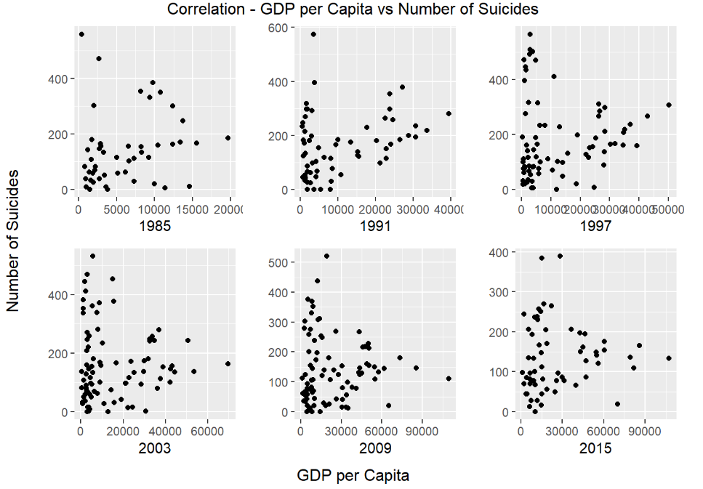

Slide 5

SUICIDE PATTERNS - MALE & FEMALE
02
AIM : To get information about the suicides committed by Male & Female over the years

Slide 6
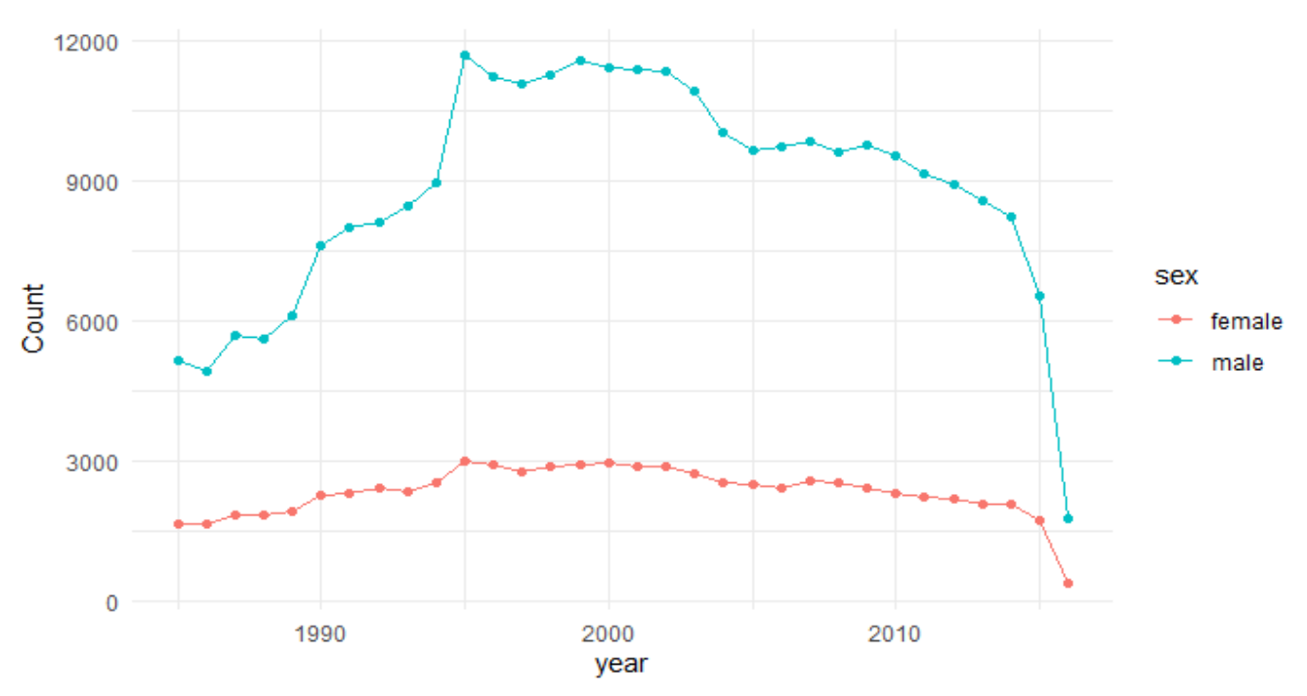

Slide 7

SUICIDES ACROSS THE COUNTRIES OVER THE YEARS
03
AIM : To find out how the suicide pattern has changed over the years

Slide 8
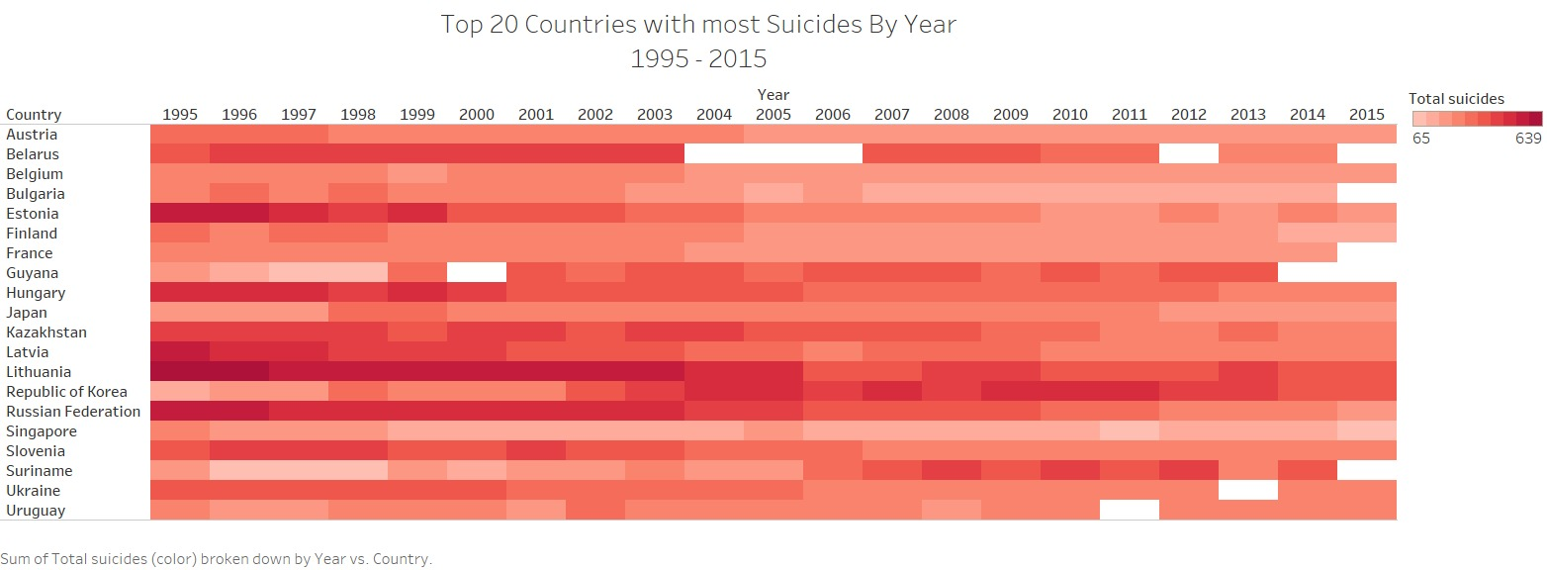

Slide 9

HYPOTHESIS TESTING
04
AIM : To find out whether the mean number of suicides of the sample is less than the true mean value

Slide 10
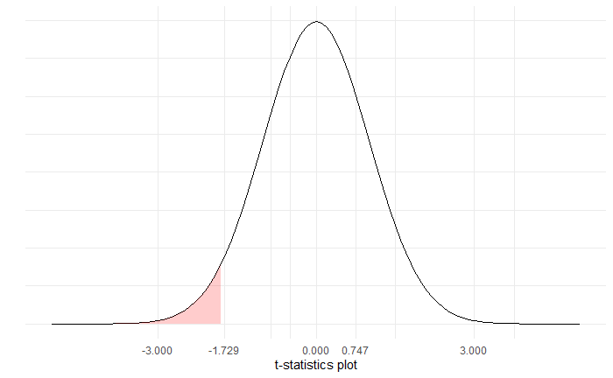
HYPOTHESIS TESTING
STATING THE HYPOTHESIS
H0: Mean number of suicides are equal to population mean
H1:Mean number of suicides are less than population mean
CALCULATING THE TEST STATISTIC
alpha - error = 0.05
Tcalc = 0.747
tvalue = -1.72 with df = 19
SPECIFYING THE DECISION RULE
p-value = 0.768
MAKING THE DECISION
Since p-value > alpha,
We fail to reject H0

Slide 11
HYPOTHESIS TESTING
05
AIM : To test the difference in mean number of suicides between Generation X & Boomers

Slide 12
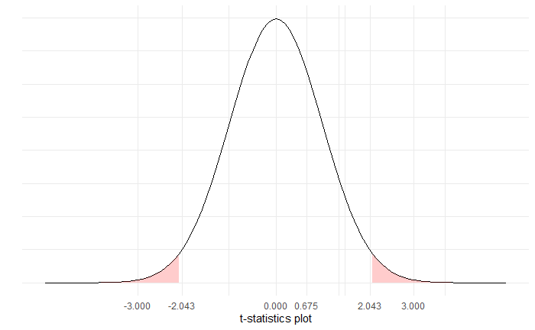
HYPOTHESIS TESTING
STATING THE HYPOTHESIS
H0: There is no difference in mean number of suicides between 15-24 & 25-34
H1: There is a significant difference in mean number of suicides between 15-24 & 25-34
CALCULATING THE TEST STATISTIC
alpha - error = 0.05
Tcalc = 0.675
tvalue = -2.042 with df = 29.988
SPECIFYING THE DECISION RULE
p-value = 0.247
MAKING THE DECISION
Since p-value > alpha,
We fail to reject H0

Slide 13
CONFIDENCE INTERVAL
06
AIM : To find the confidence interval of difference of means between the number of suicides committed by female and number of suicides committed by male

Slide 14
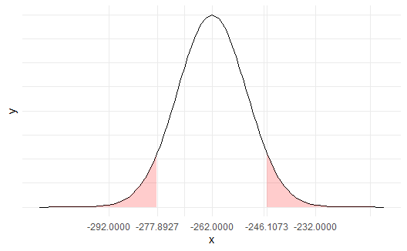
CONFIDENCE INTERVAL
WHY?
To find out whether a particular gender is more prone to committing suicides.
To determine whether the gender plays a major role in committing suicides
OBSERVATIONS
Since the upper limit and lower limits are negative, it is clearly evident that men are more prone to commit suicide than women

Slide 15

THANK YOU !
Does anyone have any questions?

Slide 16

Kindly Rate Us Using the QR Code

